Slide 1
PROGRAMMING
With JAVA
Intro to Java

Slide 2
CONTENTS OF THIS LECUTURE
Here’s what you’ll find in this Lecuture:
History of Java and what is java.
Data Types. And output
Comments and escape sequence
Inputs and the relation of classes.
Arithmetic operations and precedence (also increment and special assignment).
Conditions.
Loops (also break and continue).
Methods and functions , Overloading.
Intro to Arrays.
Assignment.

Slide 3
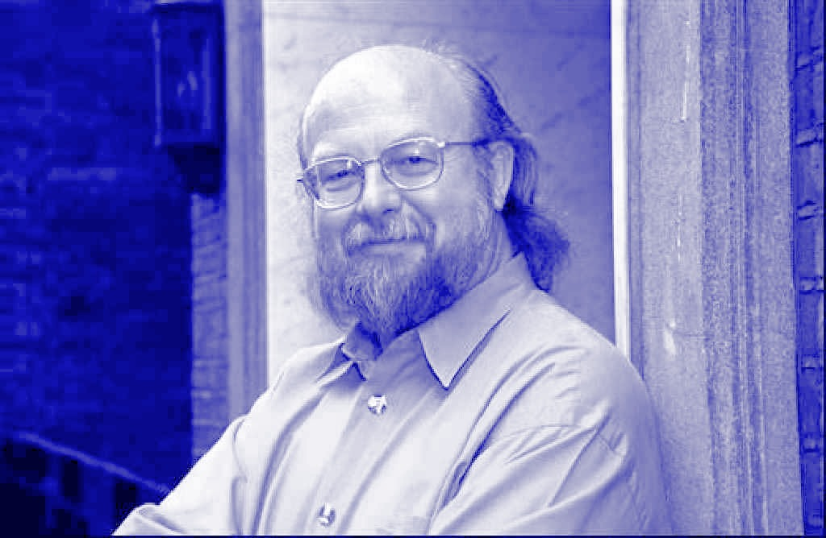
INTRODUCTION
James Gosling is the java Inventor.
Java is one of the most popular Programming Languages.
He Started working on the project in 1991 under the name oak.

Slide 4
– Martin Fowler
“Any fool can write code that a computer can understand. Good programmers write code that humans can understand.”

Slide 5
01
OVERVIEW

Slide 6
What is Java?
Java is a high level language built From C which is the first HIGH LEVEL LANGUAGE that built from the LOW Level Language
(Assemply).
Java is case sensitive language.

Slide 7
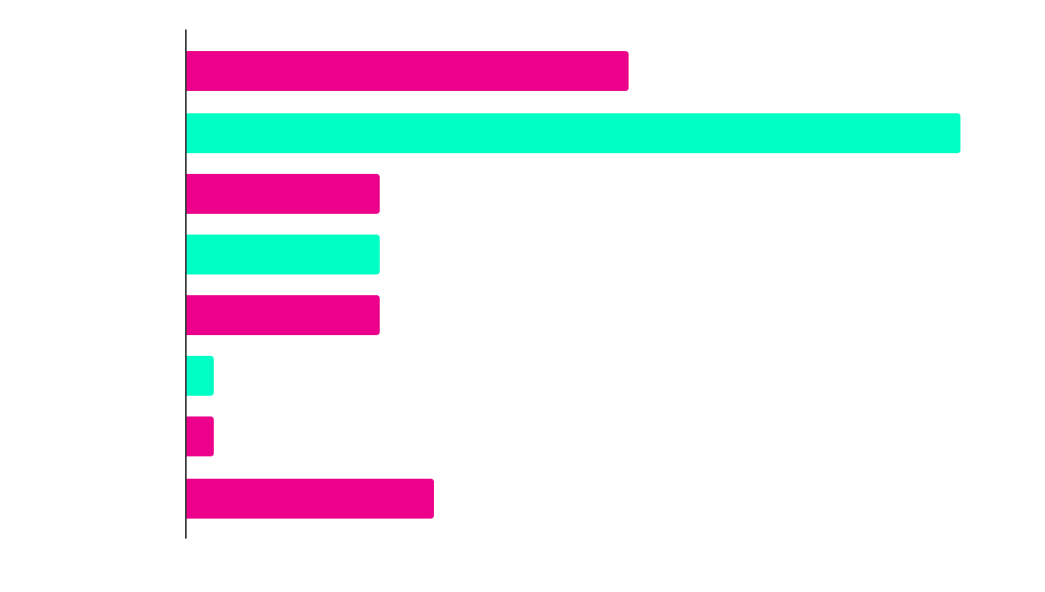
DID YOU KNOW THIS?
Average Popularity of Programming Language

Slide 8
DEFINITION OF CONCEPTS
JAVA Development KIT(JDK)
Java Runtime Error(JRE)
Java Virutal Machine(JVM)
RESPONSIBLE FOR BUILDING THE PROGRAM, WITH its tools.
RESPONSIBLE FOR Running THE PROGRAM, by packages classes , runtime libraries and JVM.
RESPONSIBLE FOR Running THE PROGRAM in all OS, by Java Compiler/Java IN Time (JIT) and Java Interpreter.

Slide 9
FEATURES OF JAVA
Interpreter
Compiler
Works Everywhere
Translate each line Separately
Translate the Whole Program at once
By translating each line that make a Byte code

Slide 10
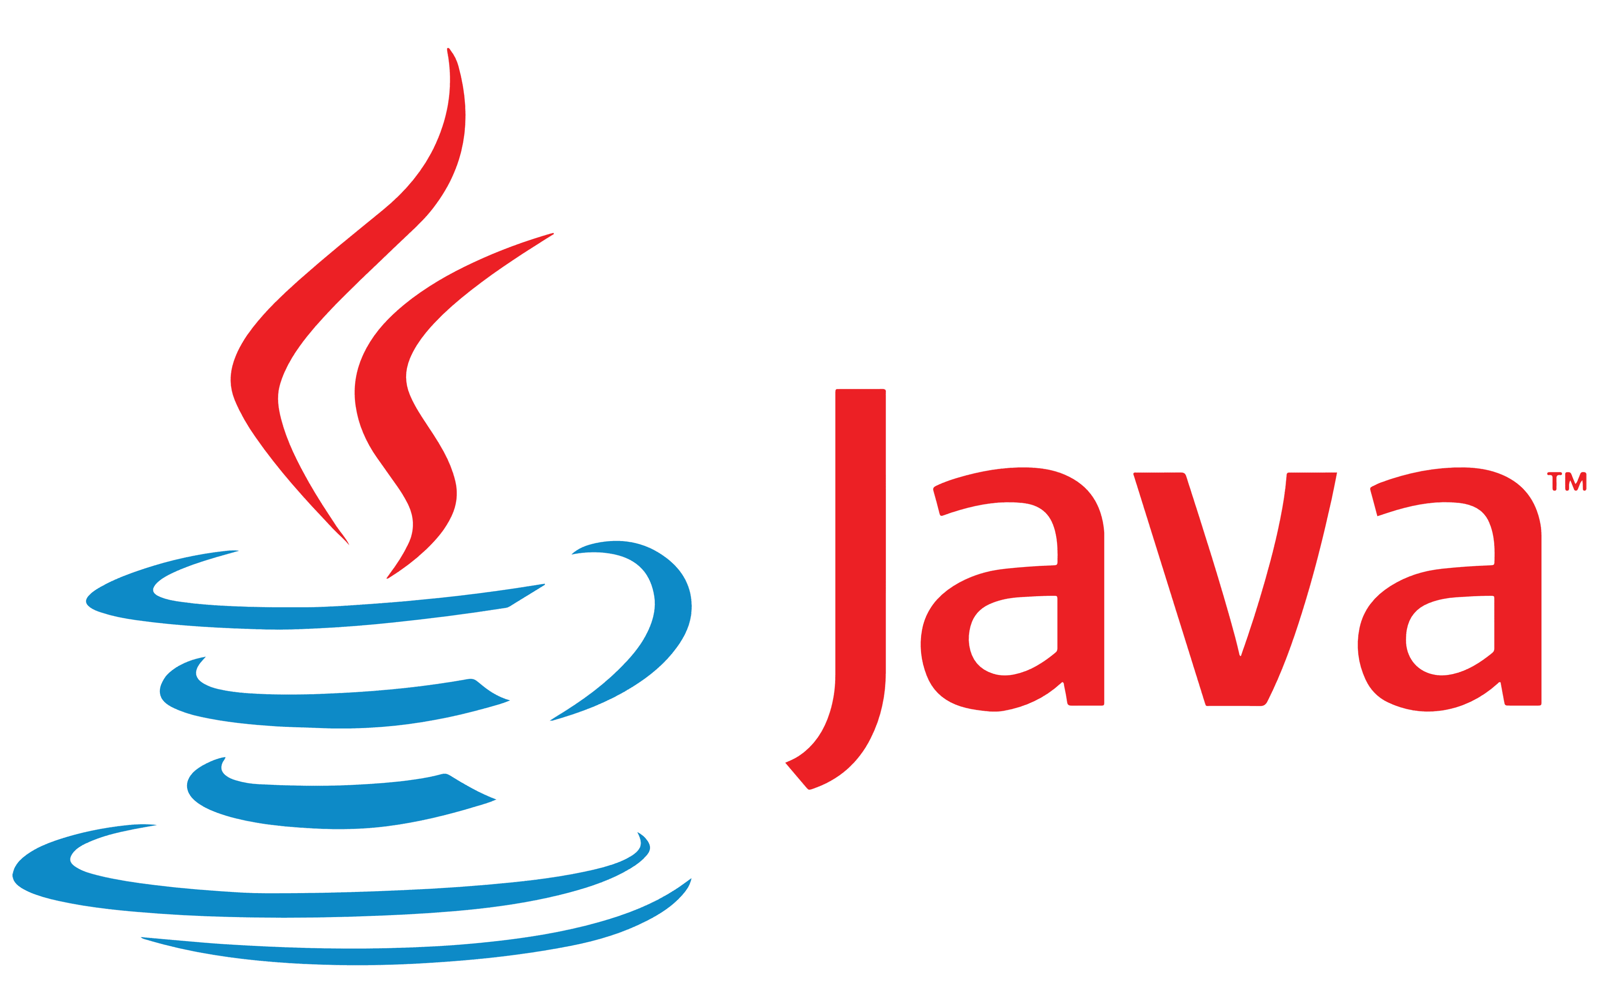
Feuture
Java handles its own Garbage automatically, and there is no pointer used in java.
It's owned by Oracle.
Java is used in all systems

Slide 11
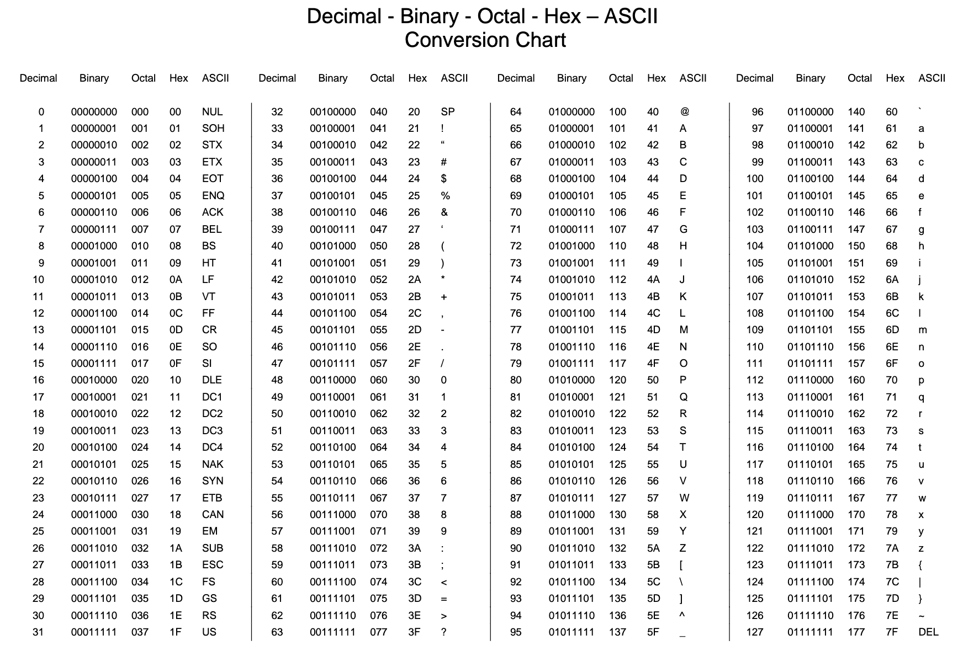
ASCII
Notes:
The ASCII (American Standard Code for Information Interchange) is a character encoding standard for electronic communication. Unicode (Universal Character Set) is a computing industry standard for consistent encoding, representation, and handling of text expressed in most of the world’s writing systems.
Ascii code is 7 bit range while there is Unicode which is takes 1 to 4 bytes,
Unicode and ASCII are the standards for text encoding, and they hold the utmost significance in modern communications. Both have their advantages and disadvantages, but a more universal solution for encoding will always facilitate and create ease in communication in the future.
Read more : https://stackoverflow.com/questions/5290182/how-many-bytes-does-one-unicode-character-take

Slide 12

Java Keywords

Slide 13

DATA TYPES AND OUTPUTS.

Slide 14
Data Types
First Bit from left is for sign.
 | Size | Name | Size
Int | 4 bytes | Bolean | 1 byte
byte | 8 bits | float | 4 bytes
short | 2 bytes | double | 8 bytes
long | 8 bytes | String | Array of char
char | 2 bytes
Name

Slide 15
Data Types
General Form :
DataType varName; // declare
varName = value; // initialize
DataType varName = value;
Primitive data types don’t need to initialized as classes unlike Non-primitive.
We can use casting to convert data types.
You can use keyword final to make variable constant.

Slide 16
Output

Slide 17
Output

Slide 18
Comments and escape sequence

Slide 19
Comments
We use // for line comment or /* */ for multiple line commenting
Use // TODO to mark a place in ide you want to back to.
Escape Sequence
Description | Escape Sequence
Insert a tab in the text at this point. | \t
Insert a backspace in the text at this point. | \b
Insert a newline in the text at this point. | \n
Insert a carriage return in the text at this point. | \r
Insert a form feed in the text at this point. | \f
Insert a symbol character in the text at this point. | \’ , \” , \\

Slide 20
Inputs

Slide 21
Input

Slide 22
Arithmetic operations

Slide 23
Arithmetic operations
Description | Symbol
add | +
subtract | -
divide | \
multiply | *
modulus | %
NOTE: The priority is for () then * , / , % then + , - from left to right.
Arithmetic operations not available with short and byte data types.

Slide 24
Increment and Decrement
Increment : (var = var + 1)
Pre-increment: ++var
Post-increment: var++
Decrement : (var = var - 1)
Pre-decrement : --var
Post-decrement : var--
Special assignment statements
Var A.O. = num
i.e. Var * = 2 -> Var = Var * 2

Slide 25
Logical Operator
And (&&) ex: T && T = T
Or (||) ex: T || F = T
Not (!) ex: !T = F
FOR BITS we use Bitwise Operators
And (&) ex: 1 & 1 = 1
Or (|) ex: 1 | 1 = 1
Xor (^) ex: 1 ^ 1 = 0
1’s complement (~) ex: ~1 = 0
Left shift (<<)
Right shift (>>)
Right zero shift (>>>)

Slide 26
Conditions

Slide 27
Relation Expression and Operators
Meaning | Operator
Equal to | ==
Not Equal to | !=
Less than | <
Less than or Equal | <=
Greater than | >
Greater than or Equal | >=

Slide 28
Conditions
There is two types of Conditions in Java :
IF Condition
Switch case
IF condition :
General syntax:
If (condition1)
{statements1;}
Else if(condition2) {statements2;}
…
Else {statements;}
Could use nested if.
Condition maybe complex.
Else statement could be another if.
- What is different between if if and if else?

Slide 29
Samples
Write a program that check if the entered number is even or odd and if its positive print +ve e/o.
Write a program that check if two numbers are equal or one of them is greater.
Ternary operator :
Is a simpler way of if condition.
Syntax:
Condition ? True statement : False Statement;
Ex:
String v = obj != null ? Obj.getValue() : null;
And it’s Equivalent of if:
String v = null;
If(obj != null)
{
v = obj.getValue();
}

Slide 30
Conditions
Switch .. Case:
General syntax:
Switch (Expression)
{
case const :
Statements;
Break;
default: // not necessary
Statements;
}
Expression is an integer value and can’t be float , chars converted using ascii to an integer.
Samples:
Write a program to tell u if the entered char is vowel (e,o,i,u,a) or not.
Write a program that tell u the grade when you entered the equivalent char.

Slide 31
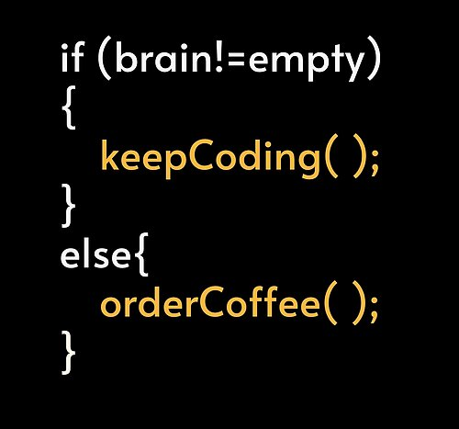
Break

Slide 32
Loops

Slide 33
Loop
Repeating a sequence of instructions or an operation a certain number of times.
The loop is one of the most widely used programming techniques.
Very important in reusability.
You can make nested loops.
Could use break statement inside loop and continue.
There is two ways in looping
While loop and Do while loop
For loop

Slide 34
Reptation control statement
While Loop :
Syntax :
While (condition)
{
statements;
}
Don’t forget to make changed counter to make the loop finite.
While the condition is true the loop is continuous.

Slide 35
Reptation control statement
Do While Loop :
Syntax :
do {
statements;
}
While (condition);
Samples:
Write a program that asks the user to enter positive number which are added together (to stop the addition enter a negative number).
Write a program that calculate factorial.

Slide 36
Reptation control statement
For Loop :
Syntax :
for(initialize counter; condition (test counter); change counter)
{
statements;
}
Samples:
Write a program that asks the user to enter positive number which are added together to stop the addition enter a negative number.
Write a program that shows a menu and ask user to choose one choice.

Slide 37

Solving
Problem
Let’s Try to solve some examples.

Slide 38
Draw Patterns

Slide 39
Draw Patterns

Slide 40
Let’s Try

Slide 41
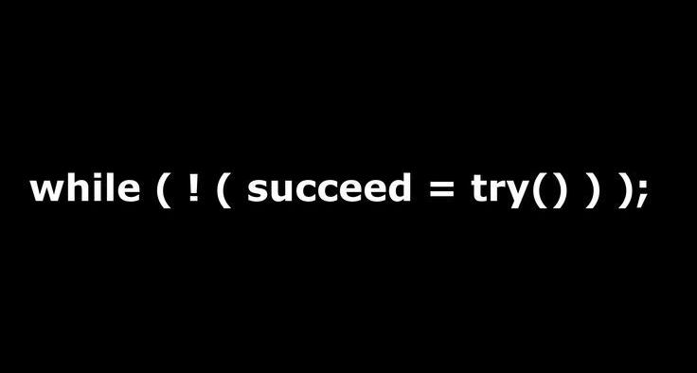
Break

Slide 42
Methods

Slide 43
Methods
Very important in reusability , write once and call infinity.
There is 4 types in methods depends on returning and arguments.
functions is a method without class.
Every function in the program make it as a method , you may reuse it later.
Types:
Non return , no argument
Non return , argument
Return , no argument
Return , argument
Choosing one of them depends on what do you need.

Slide 44
Methods
General Syntax :
return-type/void methodName([arguments/parameters])
{
statements;
return value; // if not void
}
There is built-in functions (like math library)
You can print result of a function!
Scope of variable : each variable can be read inside its nearest Curly brackets {} , can't’ be used outside the block.
Use private/public/protected/default to determine who could see the method or attributes.
Call static methods inside other static methods.
You can’t create methods with the same signature.

Slide 45
overloading
Method signature represents by the method name, return type and parameters.
We can overload a method by changing the signature , so if the name is constant then you must change either return type or parameters (parameters name doesn’t matter).
Recursion
Using a method like a loop , the method calls itself.
If there isn’t a break condition it goes infinity which cause a stack overflow error.
Ex:
int factorial (int n)
{
if (n<=1) return 1; // break condition
return n * factorial (n-1);
}

Slide 46
Arrays

Slide 47
Arrays
Array is an object that could contain many variables while variable can store only one value.
There are many diminutions arrays but the simplest one is 1D.
General Syntax:
Datatype [] arrayName = new Datatype [size]; // declaration and initialize an empty array
Use keyword new to make a new object.
The size is an integer , and the index is a pointer to an array cells and it starts from 0 , ends with size-1;
You can use objects instead of datatypes.
You can declare and initialize and fill at the same time a fixed array with the following syntax:
Datatype arrayName = {elements};
You can use loop to print or fill an array.
When you copy an array, you copy with index each elements or you will copy the location (each of them will point to the same array).

Slide 48
Coding PROCESS
Step 1
Step 2
Step 3
Step 4
Step 5
Step 6
Understand the problem
Try to generate ideas
With pen and paper
Find the best idea to solve the problem
Start to write the code that describe the problem
Test the code and debug
Improve it and publish

Slide 49

ASSIGNMENT
Write a program that calculate an area of a circle infinte times, And if r<1 stop.
___

Slide 50

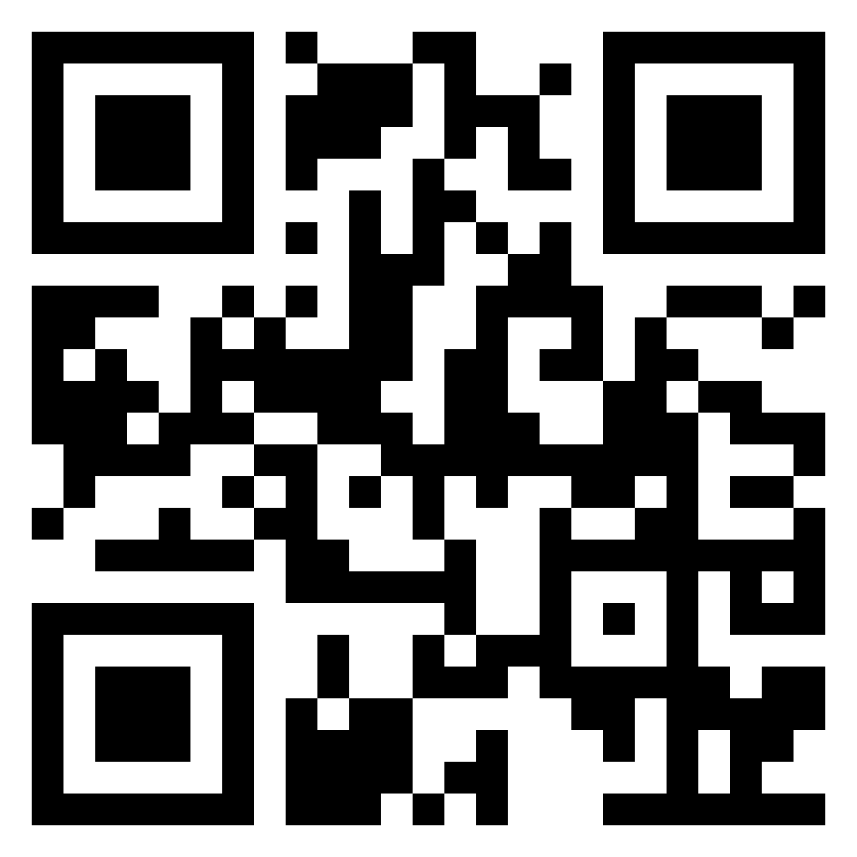

THANKS!
Do you have any questions?
amabdo30@gmail.com

